Slide 1
A Quick Tour of Python
Amey Karkare
Dept. of CSE
IIT Kanpur

Slide 2
Acknowledgements
MS Office clip art, various websites and images
The images/contents are used for teaching purpose and for fun. The copyright remains with the original creator. If you suspect a copyright violation, bring it to my notice and I will remove that image/content.

Slide 3
About me
http://www.cse.iitk.ac.in/~karkare

Slide 4
The Programming Cycle for Python

Slide 5
Run
with some input
Write/Edit
OK?
NO
YES
YES
NO
More Inputs?

Slide 6
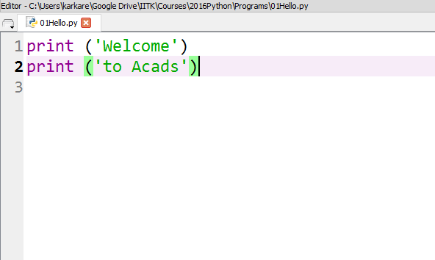
User Program
Filename, preferred extension is py

Slide 7
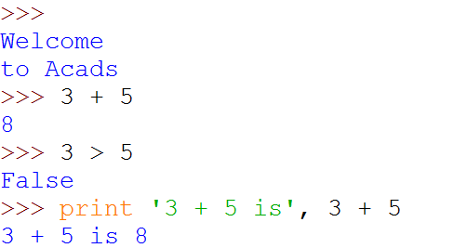
Python Shell is Interactive
IN[1]:
Python Shell Prompt
IN[2]:
User Commands
(Statements)
IN[3]:
IN[4]:
(
)
Outputs

Slide 8
Interacting with Python Programs
Python program communicates its results to user using print
Most useful programs require information from users
Name and age for a travel reservation system
Python 3 uses input to read user input as a string (str)

Slide 9

input
Take as argument a string to print as a prompt
Returns the user typed value as a string
details of how to process user string later
IN[1]:
(
)
IN[2]:
IN[3]:

Slide 10
Elements of Python
A Python program is a sequence of definitions and commands (statements)
Commands manipulate objects
Each object is associated with a Type
Type:
A set of values
A set of operations on these values
Expressions: An operation (combination of objects and operators)

Slide 11
Types in Python
int
Bounded integers, e.g. 732 or -5
float
Real numbers, e.g. 3.14 or 2.0
long
Long integers with unlimited precision
str
Strings, e.g. ‘hello’ or ‘C’

Slide 12
Types in Python
Scalar
Indivisible objects that do not have internal structure
int (signed integers), float (floating point), bool (Boolean), NoneType
NoneType is a special type with a single value
The value is called None
Non-Scalar
Objects having internal structure
str (strings)

Slide 13
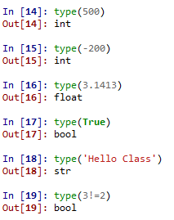
Example of Types

Slide 14
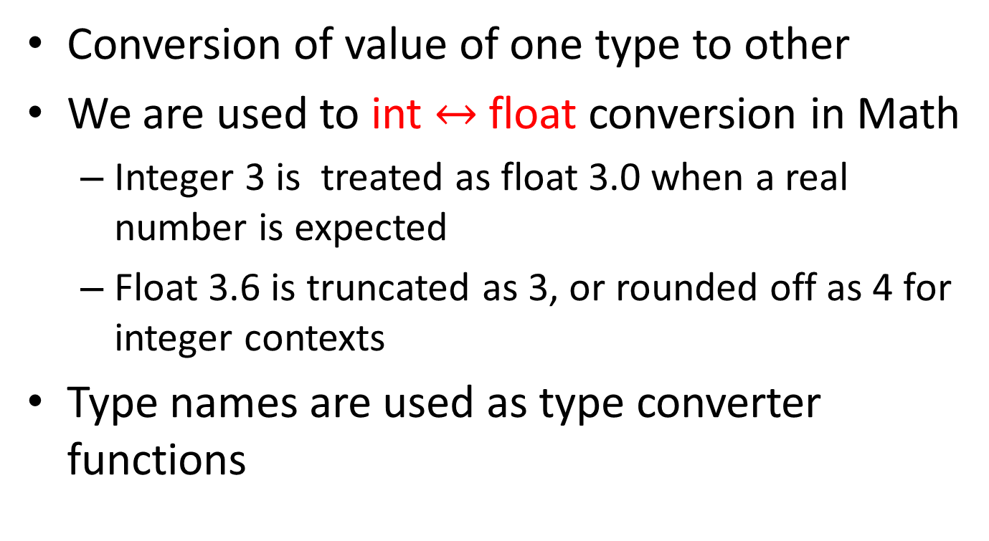
Type Conversion (Type Cast)
Conversion of value of one type to other
We are used to int $↔$float conversion in Math
Integer 3 is treated as float 3.0 when a real number is expected
Float 3.6 is truncated as 3, or rounded off as 4 for integer contexts
Type names are used as type converter functions

Slide 15
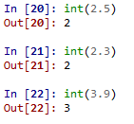


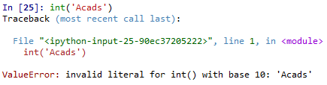
Type Conversion Examples
Note that float to int conversion
is truncation, not rounding off

Slide 16
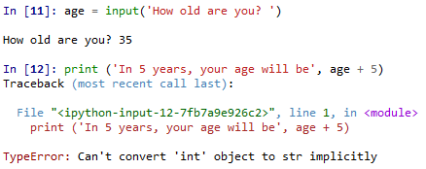
Type Conversion and Input

Slide 17
Operators
Arithmetic
Comparison
Assignment
Logical
Bitwise
Membership
Identity
+ | - | * | // | / | % | **
== | != | > | < | >= | <=
= | += | -= | *= | //= | /= | %= | **=
and | or | not
& | | | ^ | ~ | >> | <<
in | not in
is | is not

Slide 18
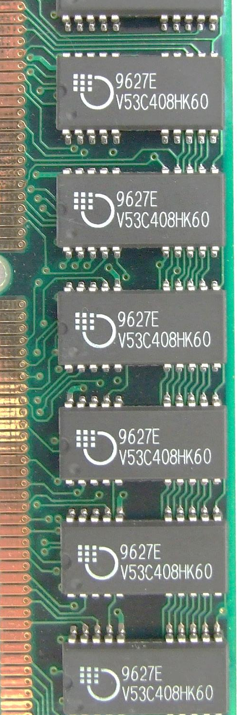
Variables
m
A name associated with an object
Assignment used for binding
m = 64;
c = ‘Acads’;
f = 3.1416;
Variables can change their bindings
f = 2.7183;
64
Acads
c
3.1416
f
2.7183

Slide 19
Assignment Statement
A simple assignment statement
Variable = Expression;
Computes the value (object) of the expression on the right hand side expression (RHS)
Associates the name (variable) on the left hand side (LHS) with the RHS value
= is known as the assignment operator.

Slide 20
Multiple Assignments
Python allows multiple assignments
x, y = 10, 20
Evaluation of multiple assignment statement:
All the expressions on the RHS of the = are first evaluated before any binding happens.
Values of the expressions are bound to the corresponding variable on the LHS.
x, y = 10, 20
x, y = y+1, x+1
Binds x to 10 and y to 20
x is bound to 21 and y to 11 at the end of the program

Slide 21
Programming using Python
Operators and Expressions

Slide 22
Binary Operations
Op | Meaning | Example | Remarks
+ | Addition | 9+2 is 11
 |  | 9.1+2.0 is 11.1
- | Subtraction | 9-2 is 7
 |  | 9.1-2.0 is 7.1
* | Multiplication | 9*2 is 18
 |  | 9.1*2.0 is 18.2
/ | Division | 9/2 is 4.25 | In Python3
 |  | 9.1/2.0 is 4.55 | Real div.
// | Integer Division | 9//2 is 4
% | Remainder | 9%2 is 1

Slide 23
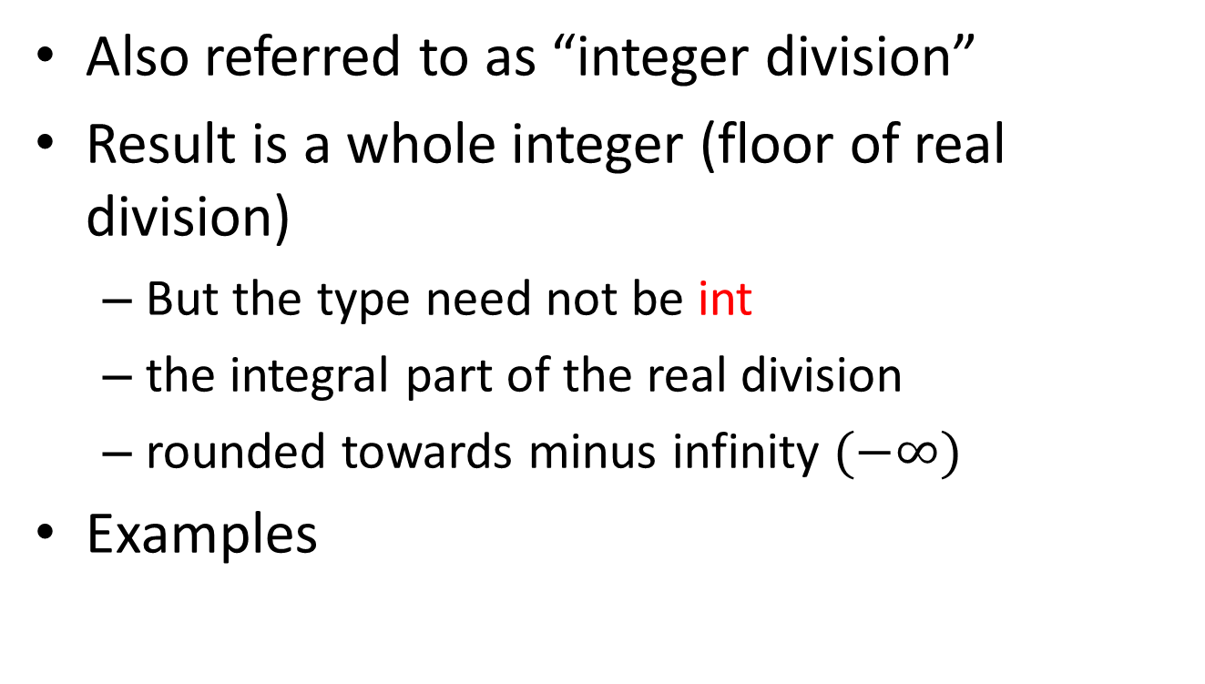
The // operator
Also referred to as “integer division”
Result is a whole integer (floor of real division)
But the type need not be int
the integral part of the real division
rounded towards minus infinity $(−∞)$
Examples
9//4 is 2 | (-1)//2 is -1 | (-1)//(-2) is 0
1//2 is 0 | 1//(-2) is -1 | 9//4.5 is 2.0

Slide 24
The % operator
The remainder operator % returns the remainder of the result of dividing its first operand by its second.
9%4 is 1 | (-1)%2 is 1 | (-1)//(-2) is 0
9%4.5 is 0.0 | 1%(-2) is 1 | 1%0.6 is 0.4
Ideally: x == (x//y)*y + x %y

Slide 25


Conditional Statements
In daily routine
If it is very hot, I will skip exercise.
If there is a quiz tomorrow, I will first study and then sleep. Otherwise I will sleep now.
If I have to buy coffee, I will go left. Else I will go straight.

Slide 26
if-else statement
Compare two integers and print the min.
if x < y:
print (x)
else:
print (y)
print (‘is the minimum’)
Check if x is less than y.
If so, print x
Otherwise, print y.

Slide 27
Indentation
Indentation is important in Python
grouping of statement (block of statements)
no explicit brackets, e.g. { }, to group statements
x,y = 6,10
if x < y:
print (x)
else:
print (y)
print (‘is the min’)
Run the program
x
y
6
10
skipped
Output
6

Slide 28
if statement (no else!)
General form of the if statement
Execution of if statement
First the expression is evaluated.
If it evaluates to a true value, then S1 is executed and then control moves to the S2.
If expression evaluates to false, then control moves to the S2 directly.
if boolean-expr :
S1
S2
true
false
S1
S2

Slide 29
if-else statement
General form of the if-else statement
Execution of if-else statement
First the expression is evaluated.
If it evaluates to a true value, then S1 is executed and then control moves to S3.
If expression evaluates to false, then S2 is executed and then control moves to S3.
S1/S2 can be blocks of statements!
if boolean-expr :
S1
else:
S2
S3
true
false
S1
S2
S3

Slide 30
Nested if, if-else
if a <= b:
if a <= c:
…
else:
…
else:
if b <= c) :
…
else:
…

Slide 31
Elif
A special kind of nesting is the chain of if-else-if-else-… statements
Can be written elegantly using if-elif-..-else
if cond1:
s1
else:
if cond2:
s2
else:
if cond3:
s3
else:
…
if cond1:
s1
elif cond2:
s2
elif cond3:
s3
elif …
else
last-block-of-stmt

Slide 32
Summary of if, if-else
if-else, nested if's, elif.
Multiple ways to solve a problem
issues of readability, maintainability
and efficiency

Slide 33

Class Quiz
What is the value of expression:
Run time crash/error
I don’t know / I don’t care
False
True
(5<2) and (3/0 > 1)
The correct answer is
False

Slide 34
Short-circuit Evaluation
Do not evaluate the second operand of binary short-circuit logical operator if the result can be deduced from the first operand
Also applies to nested logical operators
not( (2>5) and (3/0 > 1) ) or (4/0 < 2)
Evaluates to true
true
false
false
true

Slide 35
3 Factors for Expr Evaluation
Precedence
Applied to two different class of operators
+ and *, - and *, and and or, …
Associativity
Applied to operators of same class
* and *, + and -, * and /, …
Order
Precedence and associativity identify the operands for each operator
Not which operand is evaluated first
Python evaluates expressions from left to right
While evaluating an assignment, the right-hand side is evaluated before the left-hand side.
Notes:
NOTE: add example to show the effect of order of evaluation

Slide 36
Class Quiz
What is the output of the following program:
y = 0.1*3
if y != 0.3:
print ('Launch a Missile')
else:
print ("Let's have peace")
Launch a Missile

Slide 37
Caution about Using Floats
Representation of real numbers in a computer can not be exact
Computers have limited memory to store data
Between any two distinct real numbers, there are infinitely many real numbers.
On a typical machine running Python, there are 53 bits of precision available for a Python float

Slide 38
Caution about Using Floats
The value stored internally for the decimal number 0.1 is the binary fraction
Equivalent to decimal value
Approximation is similar to decimal approximation 1/3 = 0.333333333...
No matter how many digits you use, you have an approximation
0.00011001100110011001100110011001100110011001100110011010
0.1000000000000000055511151231257827021181583404541015625

Slide 39
Comparing Floats
Because of the approximations, comparison of floats is not exact.
Solution?
Instead of
x == y
use
abs(x-y) <= epsilon
where epsilon is a suitably chosen small value

Slide 40

Programming using Python
Loops

Slide 41
Printing Multiplication Table
5 | X | 1 | = | 5
5 | X | 2 | = | 10
5 | X | 3 | = | 15
5 | X | 4 | = | 20
5 | X | 5 | = | 25
5 | X | 6 | = | 30
5 | X | 7 | = | 35
5 | X | 8 | = | 40
5 | X | 9 | = | 45
5 | X | 10 | = | 50

Slide 42
Program…
n = int(input('Enter a number: '))
print (n, 'X', 1, '=', n*1)
print (n, 'X', 2, '=', n*2)
print (n, 'X', 3, '=', n*3)
print (n, 'X', 4, '=', n*4)
print (n, 'X', 5, '=', n*5)
print (n, 'X', 6, '=', n*6)
….
Too much
repetition!
Can I avoid
it?

Slide 43
Printing Multiplication Table
Loop Entry
Input n
i = 1
Loop Exit
i <=10
TRUE
FALSE
Print n X i = n*i
i = i+1
Stop
Loop

Slide 44
Printing Multiplication Table
Input n
i = 1
n = int(input('n=? '))
i = 1
while (i <= 10) :
print (n ,'X', i, '=', n*i)
i = i + 1
print ('done‘)
TRUE
i <=10
FALSE
Print n x i = ni
i = i+1
Stop

Slide 45
While Statement
while (expression):
S1
S2
FALSE
expression
TRUE
S1
S2
Evaluate expression
If TRUE then
execute statement1
goto step 1.
If FALSE then execute statement2.

Slide 46
For Loop
Print the sum of the reciprocals of the first 100 natural numbers.
rsum=0.0# the reciprocal sum
# the for loop
for i in range(1,101):
rsum = rsum + 1.0/i
print ('sum is', rsum)

Slide 47
For loop in Python
General form
for variable in sequence:
stmt

Slide 48
range
range(s, e, d)
generates the list:
[s, s+d, s+2*d, …, s+k*d]
where s+k*d < e <= s+(k+1)*d
range(s, e) is equivalent to range(s, e, 1)
range(e) is equivalent to range(0, e)
Exercise: What if d is negative? Use python interpreter to find out.

Slide 49
Quiz
What will be the output of the following program
# print all odd numbers < 10
i = 1
while i <= 10:
if i%2==0: # even
continue
print (i, end=‘ ‘)
i = i+1

Slide 50
Continue and Update Expr
Make sure continue does not bypass update-expression for while loops
# print all odd numbers < 10
i = 1
while i <= 10:
if i%2==0: # even
continue
print (i, end=‘ ‘)
i = i+1
i is not incremented
when even number
encountered.
Infinite loop!!

Slide 51
Programming using Python
f(unctions)

Slide 52
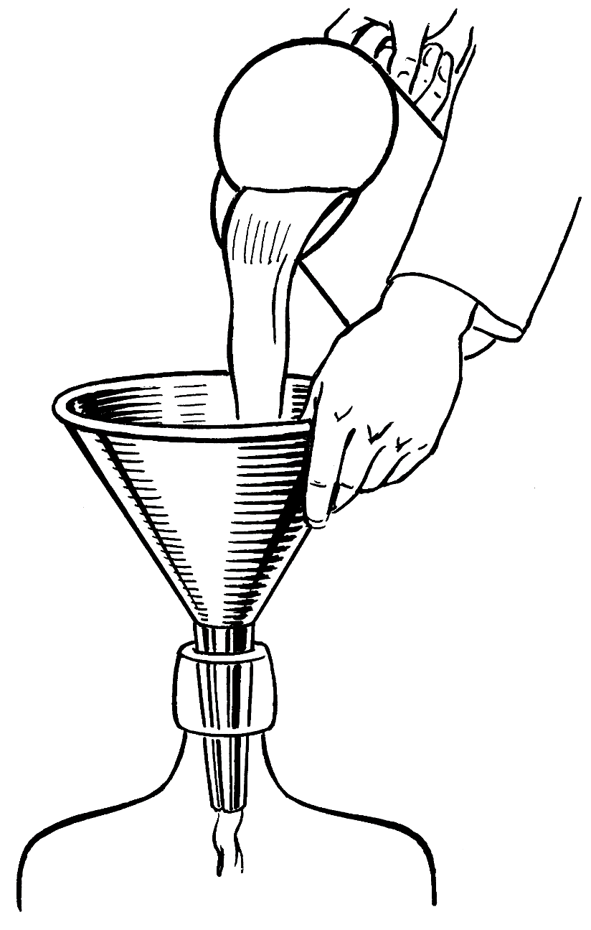
Parts of a function
Input
f
Output

Slide 53
def max (a, b):
‘’’return maximum among a and b’’’
if (a > b):
return a
else:
return b
keyword
2 arguments
a and b
(formal args)
Function Name
x = max(6, 4)
Body of thefunction,
indented w.r.t the
def keyword
Call to the function.
Actual args are 6 and 4.
Documentation comment
(docstring), type
help <function-name>
on prompt to get help for the function

Slide 54
def max (a, b):
‘‘‘return maximum among a and b’’’
if (a > b):
return a
else:
return b
In[3] : help(max)
Help on function max in module __main__:
max(a, b)
return maximum among a and b

Slide 55
Keyword Arguments
def printName(first, last, initials) :
if initials:
print (first[0] + '. ' + last[0] + '.')
else:
print (first, last)
Note use of [0] to get the first character of a string. More on this later.
Call | Output
printName('Acads', 'Institute', False) | Acads Institute
printName('Acads', 'Institute', True) | A. I.
printName(last='Institute', initials=False, first='Acads') | Acads Institute
printName('Acads', initials=True, last='Institute') | A. I.

Slide 56
Keyword Arguments
Parameter passing where formal is bound to actual using formal's name
Can mix keyword and non-keyword arguments
All non-keyword arguments precede keyword arguments in the call
Non-keyword arguments are matched by position (order is important)
Order of keyword arguments is not important

Slide 57
Default Values
def printName(first, last, initials=False) :
if initials:
print (first[0] + '. ' + last[0] + '.')
else:
print (first, last)
Note the use of “default” value
Call | Output
printName('Acads', 'Institute') | Acads Institute
printName(first='Acads', last='Institute', initials=True) | A. I.
printName(last='Institute', first='Acads') | Acads Institute
printName('Acads', last='Institute') | Acads Institute

Slide 58
Default Values
Allows user to call a function with fewer arguments
Useful when some argument has a fixed value for most of the calls
All arguments with default values must be at the end of argument list
non-default argument can not follow default argument

Slide 59
Globals
Globals allow functions to communicate with each other indirectly
Without parameter passing/return value
Convenient when two seemingly “far-apart” functions want to share data
No direct caller/callee relation
If a function has to update a global, it must re-declare the global variable with global keyword.

Slide 60
Globals
PI = 3.14
def perimeter(r):
return 2 * PI * r
def area(r):
return PI * r * r
def update_pi():
global PI
PI = 3.14159
>>> print(area (100))
31400.0
>>> print(perimeter(10))
62.800000000000004
>>> update_pi()
>>> print(area(100))
31415.999999999996
>>> print(perimeter(10))
62.832
defines PI to be of float type with value 3.14. PI can be used across functions. Any change to PI in update_pi will be visible to all due to the use of global.

Slide 61
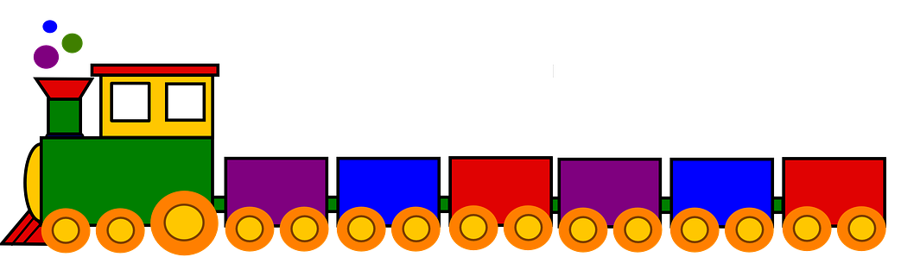
Programming with Python
S
T
R
I
N
G
S
T
U
P
L
E
S
L
I
S
T
S

Slide 62
Strings
Strings in Python have type str
They represent sequence of characters
Python does not have a type corresponding to character.
Strings are enclosed in single quotes(') or double quotes(“)
Both are equivalent
Backslash (\) is used to escape quotes and special characters

Slide 63
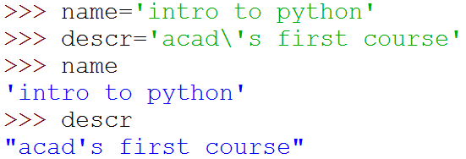

Strings
More readable when print is used

Slide 64
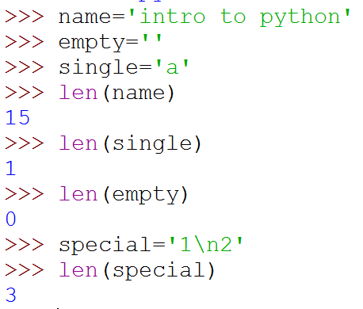
Length of a String
len function gives the length of a string
\n is a single character: the special character representing newline

Slide 65
Concatenate and Repeat
In Python, + and * operations have special meaning when operating on strings
+ is used for concatenation of (two) strings
* is used to repeat a string, an int number of time
Function/Operator Overloading

Slide 66

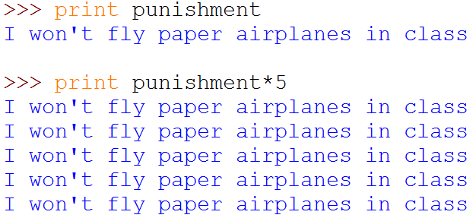
Concatenate and Repeat

Slide 67
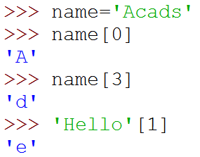
Indexing
Strings can be indexed
First character has index 0

Slide 68
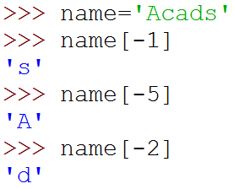
Indexing
Negative indices start counting from the right
Negatives indices start from -1
-1 means last, -2 second last, ...

Slide 69
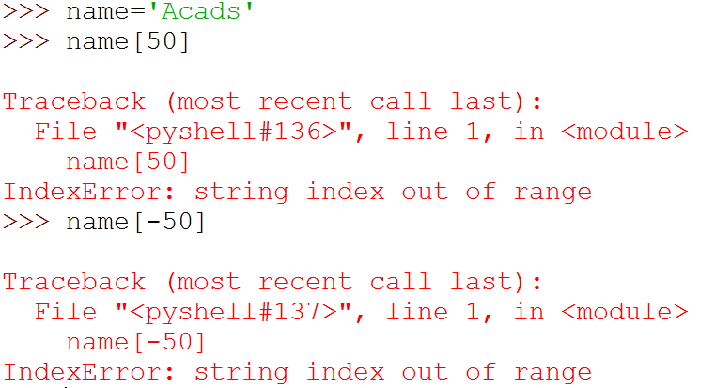
Indexing
Using an index that is too large or too small results in “index out of range” error

Slide 70
Slicing
To obtain a substring
s[start:end] means substring of s starting at index start and ending at index end-1
s[0:len(s)] is same as s
Both start and end are optional
If start is omitted, it defaults to 0
If end is omitted, it defaults to the length of string
s[:] is same as s[0:len(s)], that is same as s

Slide 71
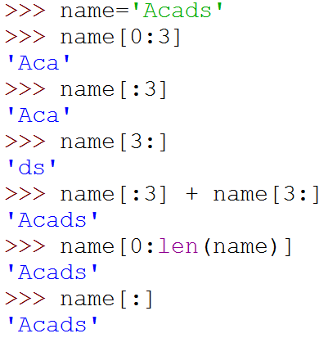
Slicing

Slide 72
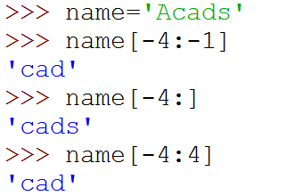
More Slicing
Understanding Indices for slicing
A | c | a | d | s
0 | 1 | 2 | 3 | 4
-5 | -4 | -3 | -2 | -1
5

Slide 73
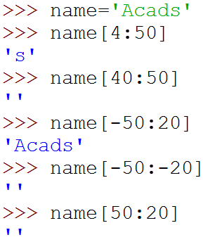

Out of Range Slicing
A | c | a | d | s
0 | 1 | 2 | 3 | 4
-5 | -4 | -3 | -2 | -1
Out of range indices are ignored for slicing
when start and end have the same sign, if start >=end, empty slice is returned
Why?

Slide 74
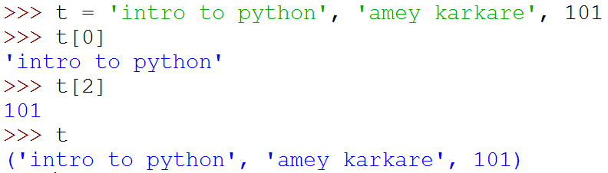
Tuples
A tuple consists of a number of values separated by commas
Empty and Singleton Tuples

Slide 75
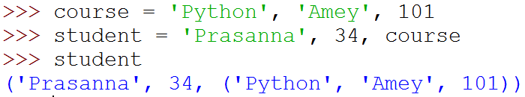

Nested Tuples
Tuples can be nested
Note that course tuple is copied into student.
Changing course does not affect student

Slide 76
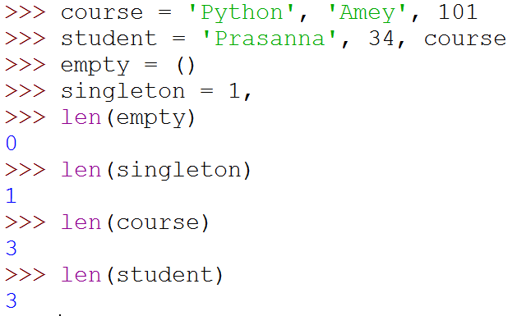
Length of a Tuple
len function gives the length of a tuple

Slide 77
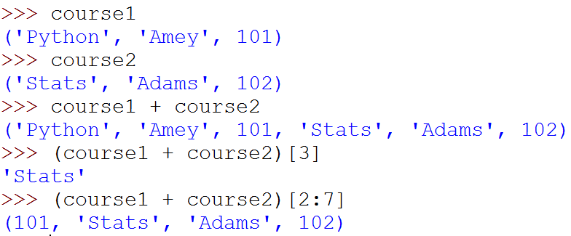
More Operations on Tuples
Tuples can be concatenated, repeated, indexed and sliced

Slide 78
Unpacking Sequences
Strings and Tuples are examples of sequences
Indexing, slicing, concatenation, repetition operations applicable on sequences
Sequence Unpacking operation can be applied to sequences to get the components
Multiple assignment statement
LHS and RHS must have equal length

Slide 79
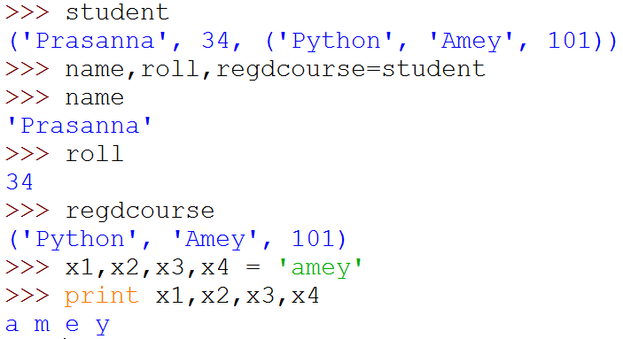
Unpacking Sequences
(
)

Slide 80
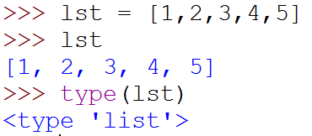
Lists
Ordered sequence of values
Written as a sequence of comma-separated values between square brackets
Values can be of different types
usually the items all have the same type

Slide 81
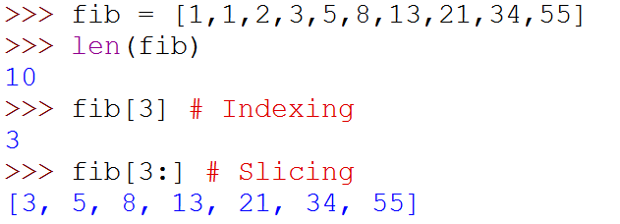
Lists
List is also a sequence type
Sequence operations are applicable

Slide 82
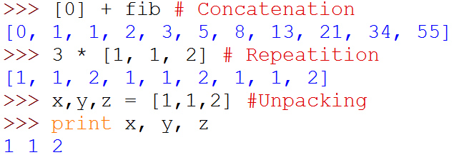
Lists
List is also a sequence type
Sequence operations are applicable
Repetition
(
)

Slide 83
More Operations on Lists
L.append(x)
L.extend(seq)
L.insert(i, x)
L.remove(x)
L.pop(i)
L.pop()
L.index(x)
L.count(x)
L.sort()
L.reverse()
x is any value, seq is a sequence value (list, string, tuple, …),
i is an integer value

Slide 84
Mutable and Immutable Types
Tuples and List types look very similar
However, there is one major difference: Lists are mutable
Contents of a list can be modified
Tuples and Strings are immutable
Contents can not be modified

Slide 85
Summary of Sequences
Operation | Meaning
seq[i] | i-th element of the sequence
len(seq) | Length of the sequence
seq1 + seq2 | Concatenate the two sequences
num*seq seq*num | Repeat seq num times
seq[start:end] | slice starting from start, and ending at end-1
e in seq | True if e is present is seq, False otherwise
e not in seq | True if e is not present is seq, False otherwise
for e in seq | Iterate over all elements in seq (e is bound to one element per iteration)
Sequence types include String, Tuple and List.
Lists are mutable, Tuple and Strings immutable.

Slide 86
Summary of Sequences
For details and many useful functions, refer to:
https://docs.python.org/3.2/tutorial/datastructures.html

Slide 87
Programming with Python
Sets and Dictionaries

Slide 88
Sets
An unordered collection with no duplicate elements
Supports
membership testing
eliminating duplicate entries
Set operations: union, intersection, difference, and symmetric difference.

Slide 89
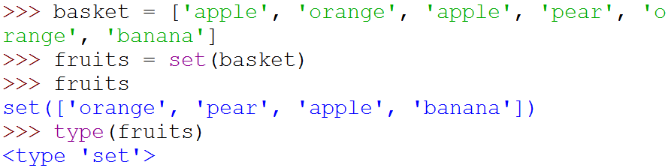
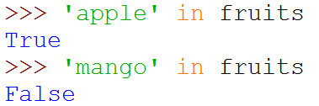
Sets
{
}
Create a set from
a sequence

Slide 90
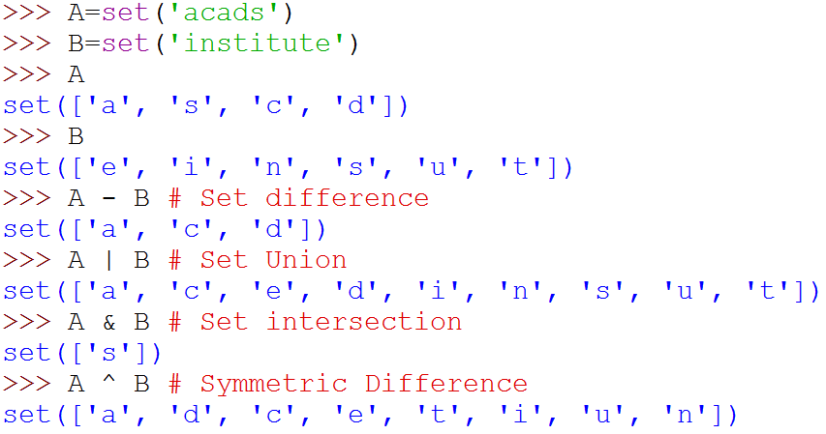
Set Operations
{
}
{
}
{
}
{
}
{
}

Slide 91
Dictionaries
Unordered set of key:value pairs,
Keys have to be unique and immutable
Key:value pairs enclosed inside curly braces {...}
Empty dictionary is created by writing {}
Dictionaries are mutable
add new key:value pairs,
change the pairing
delete a key (and associated value)

Slide 92
Operations on Dictionaries
Operation | Meaning
len(d) | Number of key:value pairs in d
d.keys() | List containing the keys in d
d.values() | List containing the values in d
k in d | True if key k is in d
d[k] | Value associated with key k in d
d.get(k, v) | If k is present in d, then d[k] else v
d[k] = v | Map the value v to key k in d (replace d[k] if present)
del d[k] | Remove key k (and associated value) from d
for k in d | Iterate over the keys in d

Slide 93
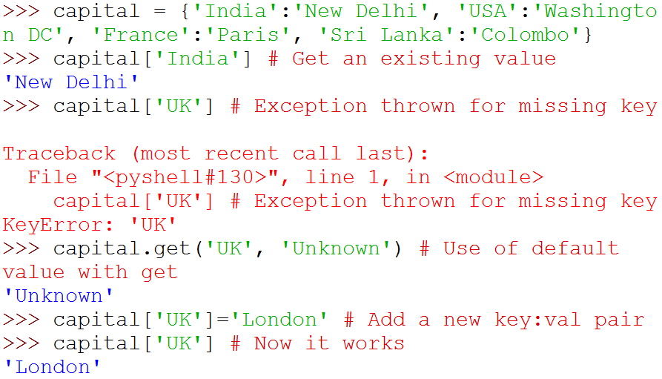
Operations on Dictionaries

Slide 94
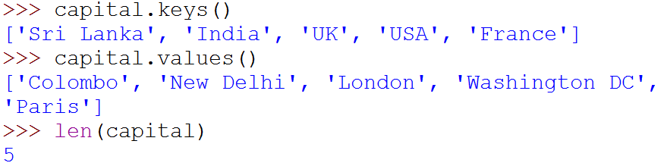
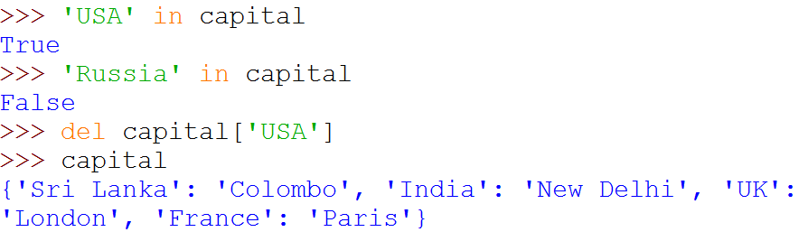
Operations on Dictionaries

Slide 95
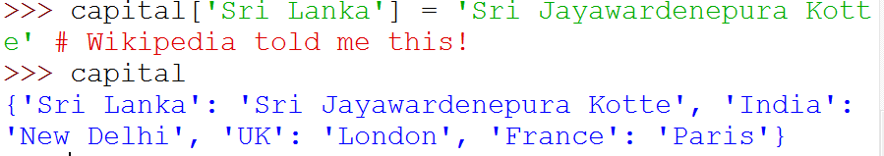
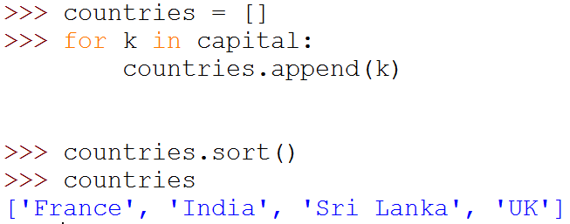
Operations on Dictionaries
# Remember: for ... in iterates over keys only
# Sort values in a list

Slide 96
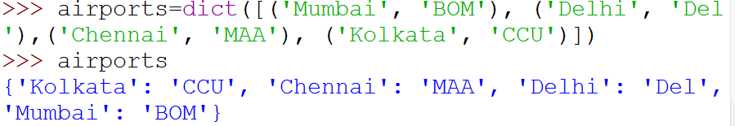
Dictionary Construction
The dict constructor: builds dictionaries directly from sequences of key-value pairs

Slide 97
Programming with Python
File I/O

Slide 98
File I/O
Files are persistent storage
Allow data to be stored beyond program lifetime
The basic operations on files are
open, close, read, write
Python treat files as sequence of lines
sequence operations work for the data read from files

Slide 99
File I/O: open and close
open(filename, mode)
While opening a file, you need to supply
The name of the file, including the path
The mode in which you want to open a file
Common modes are r (read), w (write), a (append)
Mode is optional, defaults to r
open(..) returns a file object
close() on the file object closes the file
finishes any buffered operations

Slide 100
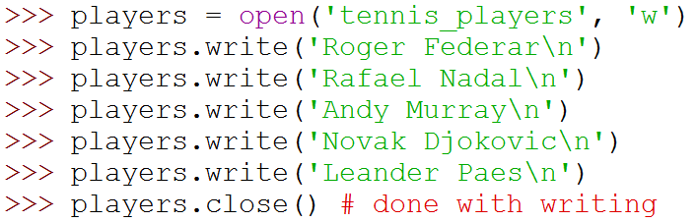
File I/O: Example
Do some writing
How to do it?
see the next few slides

Slide 101
File I/O: read, write and append
Reading from an open file returns the contents of the file
as sequence of lines in the program
Writing to a file
IMPORTANT: If opened with mode 'w', clears the existing contents of the file
Use append mode ('a') to preserve the contents
Writing happens at the end

Slide 102
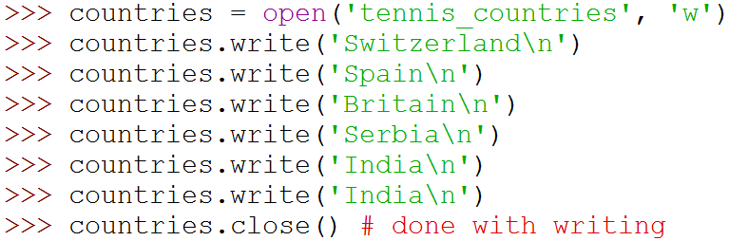
File I/O: Examples

Slide 103
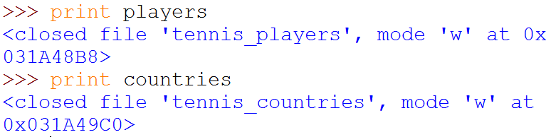
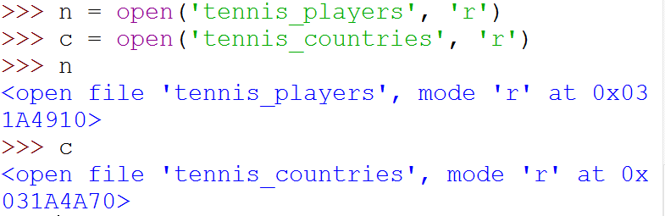
File I/O: Examples
(
)
(
)

Slide 104
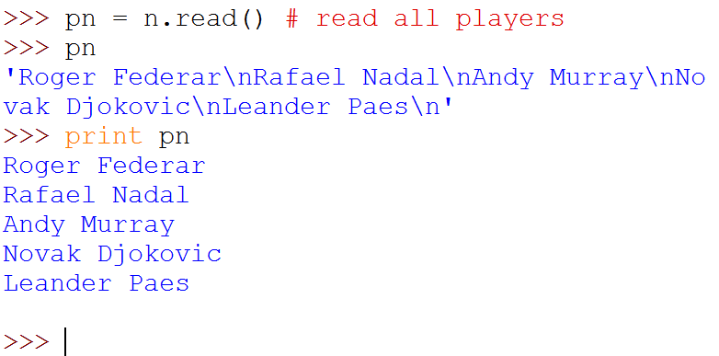

File I/O: Examples
(
)
Note empty line due to '\n'

Slide 105
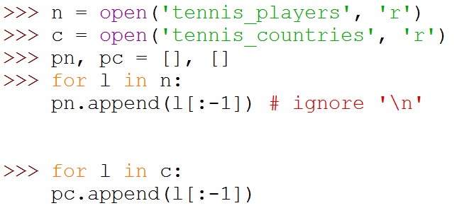

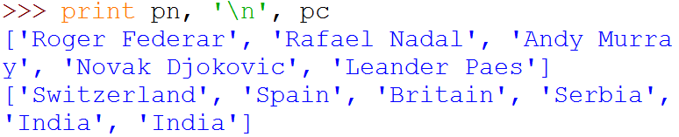
File I/O: Examples
Note the use of for ... in
for sequence
(
)
]

Slide 106
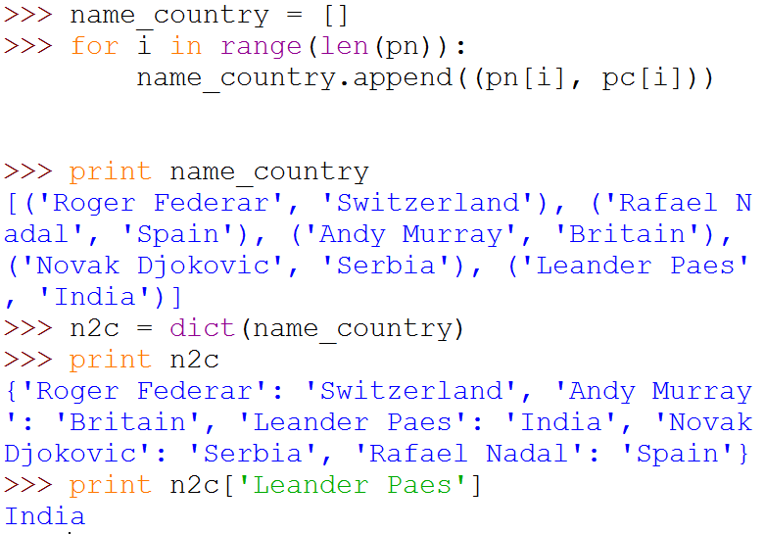
File I/O: Examples
(
)
(
)
(
)

Slide 107
Programming using Python Modules and Packages
Amey Karkare
Dept. of CSE
IIT Kanpur

Slide 108
Modules
As program gets longer, need to organize them for easier access and easier maintenance.
Reuse same functions across programs without copying its definition into each program.
Python allows putting definitions in a file
use them in a script or in an interactive instance of the interpreter
Such a file is called a module
definitions from a module can be imported into other modules or into the main module

Slide 109
Modules
A module is a file containing Python definitions and statements.
The file name is the module name with the suffix .py appended.
Within a module, the module’s name is available in the global variable __name__.

Slide 110
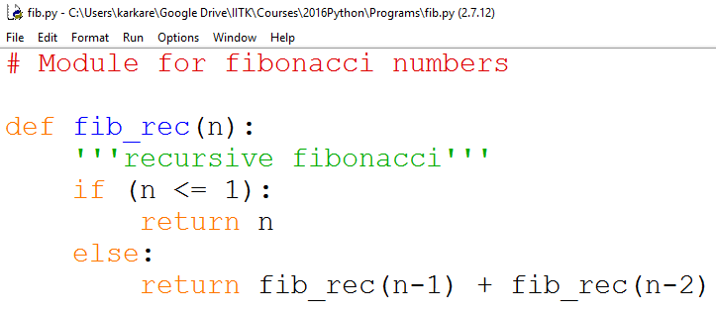
Modules Example
fib.py - C:\

Slide 111
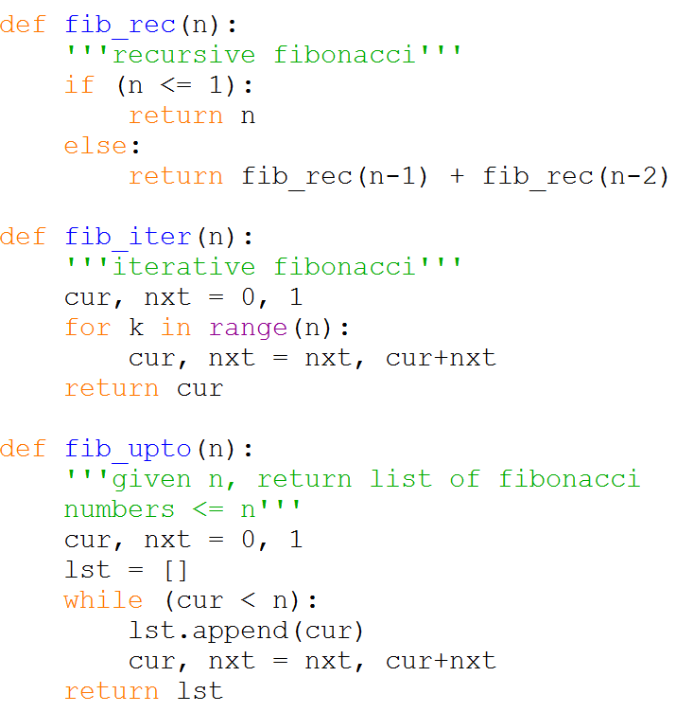
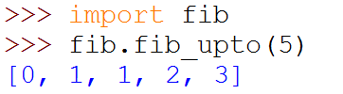
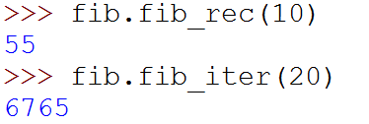

Modules Example
Within a module, the module’s name is available as the value of the global variable __name__.

Slide 112
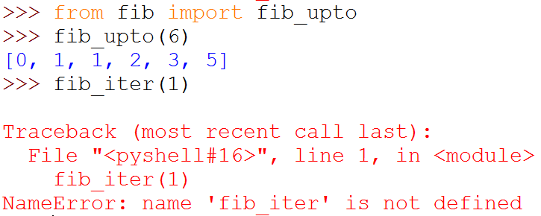
Importing Specific Functions
To import specific functions from a module
This brings only the imported functions in the current symbol table
No need of modulename. (absence of fib. in the example)

Slide 113

Importing ALL Functions
To import all functions from a module, in the current symbol table
This imports all names except those beginning with an underscore (_).

Slide 114
__main__ in Modules
When you run a module on the command line with
python fib.py <arguments>
the code in the module will be executed, just as if
you imported it, but with the __name__ set to
"__main__".
By adding this code at the end of your module
if __name__ == "__main__":
... # Some code here
you can make the file usable as a script as well as an
importable module

Slide 115
__main__ in Modules
if __name__ == "__main__":
import sys
print (fib_iter(int(sys.argv[1])))
This code parses the command line only if the module is executed as the “main” file:
$ python fib.py 10
55
If the module is imported, the code is not run:
>>> import fib
>>>

Slide 116
Package
A Python package is a collection of Python modules.
Another level of organization.
Packages are a way of structuring Python’s module namespace by using dotted module names.
The module name A.B designates a submodule named B in a package named A.
The use of dotted module names saves the authors of multi-module packages like NumPy or Pillow from having to worry about each other’s module names.

Slide 117

A sound Package
https://docs.python.org/3/tutorial/modules.html

Slide 118
A sound Package
What are these files with funny names?
https://docs.python.org/3/tutorial/modules.html

Slide 119
__init.py__
The __init__.py files are required to make Python treat directories containing the file as packages.
This prevents directories with a common name, such as string, unintentionally hiding valid modules that occur later on the module search path.
__init__.py can just be an empty file
It can also execute initialization code for the package

Slide 120
Importing Modules from Packages
https://docs.python.org/3/tutorial/modules.html

Slide 121
Importing Modules from Packages
import sound.effects.echo
Loads the submodule sound.effects.echo
It must be referenced with its full name:
sound.effects.echo.echofilter(
input, output,
delay=0.7, atten=4
)

Slide 122
Importing Modules from Packages
from sound.effects import echo
This also loads the submodule echo
Makes it available without package prefix
It can be used as:
echo.echofilter(
input, output,
delay=0.7, atten=4
)

Slide 123
Importing Modules from Packages
from sound.effects.echo import echofilter
This loads the submodule echo, but this makes its function echofilter() directly available.
echofilter(input, output,
delay=0.7, atten=4)

Slide 124
Popular Packages
pandas, numpy, scipy, matplotlib, …
Provide a lot of useful functions
Notes:
https://pandas.pydata.org/pandas-docs/stable/getting_started/tutorials.html

